Slide 1
Security
Module - 14

Slide 2
Contents
Basics
Type-Based Access Rights
Restrictions
Spring Security
Custom Access Rights

Slide 3
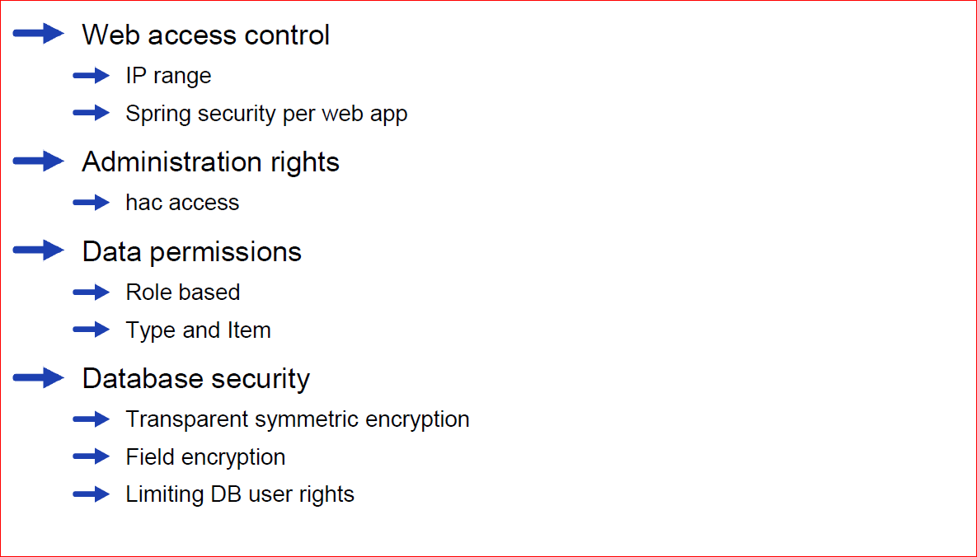
Security areas to consider

Slide 4
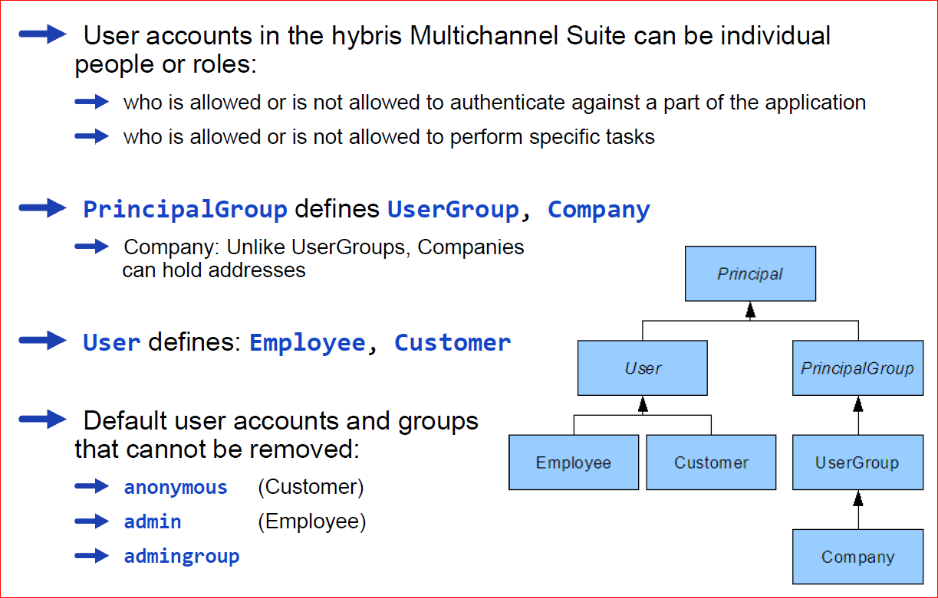
Basics

Slide 5
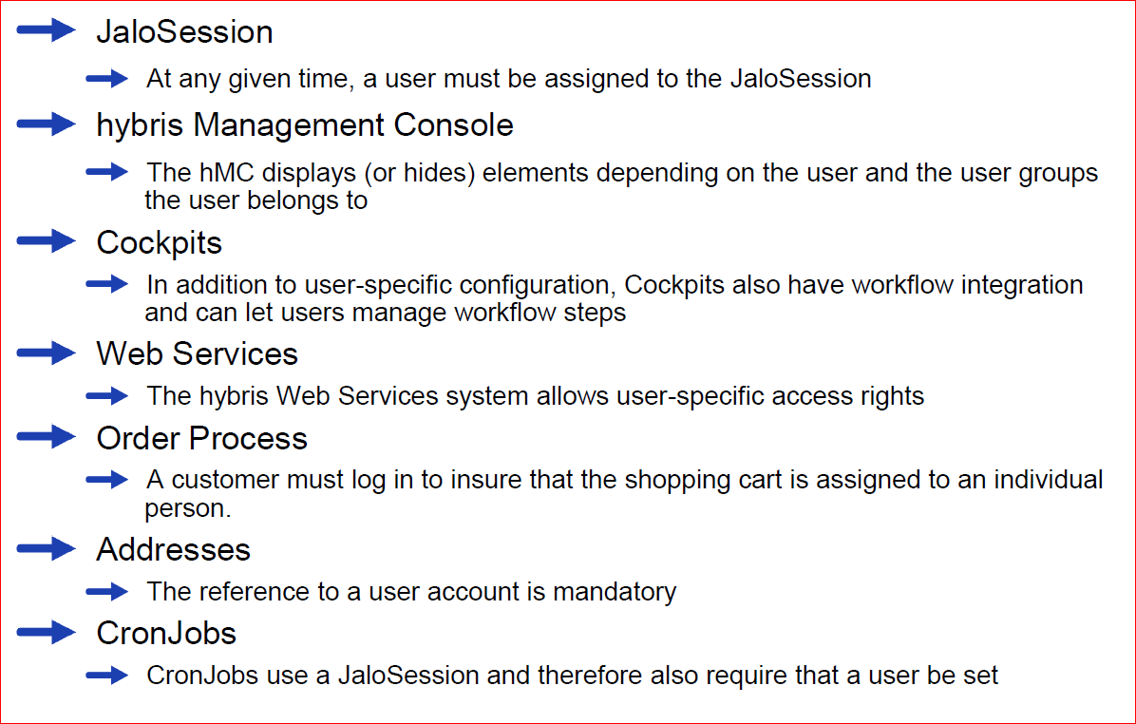
Where Do User Accounts Affect the hybris Multichannel Suite?

Slide 6
Contents
Basics
Type-Based Access Rights
Restrictions
Spring Security
Custom Access Rights

Slide 7
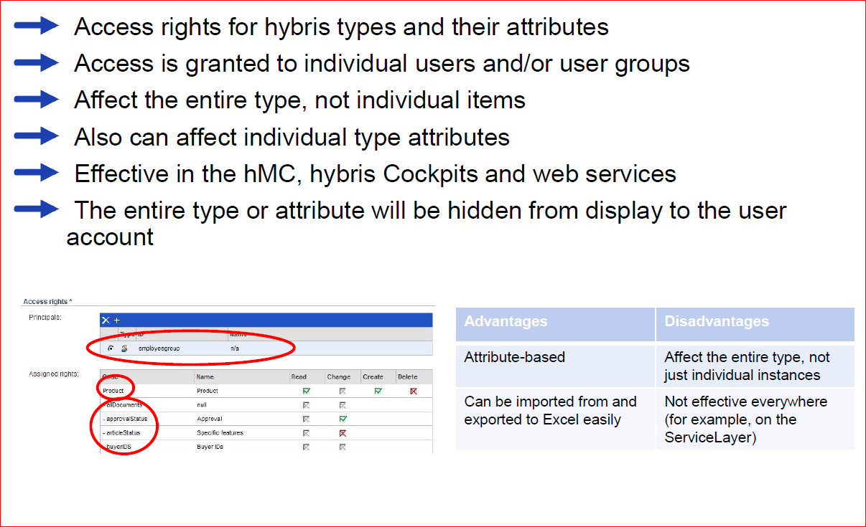
Type-Based Access Rights – Overview

Slide 8
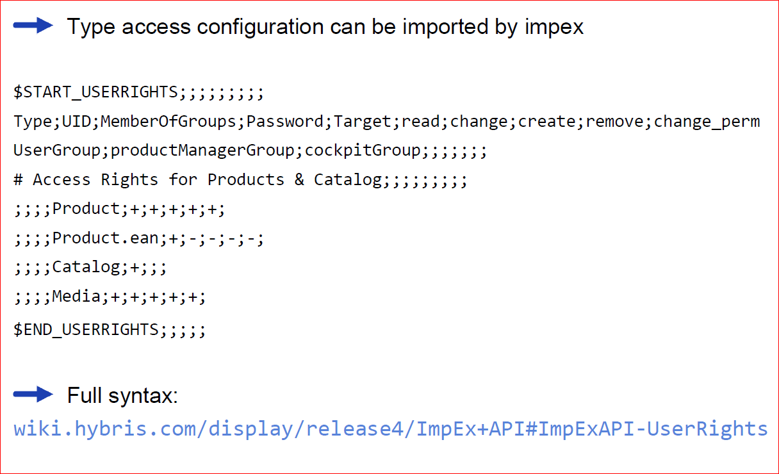
Importing

Slide 9
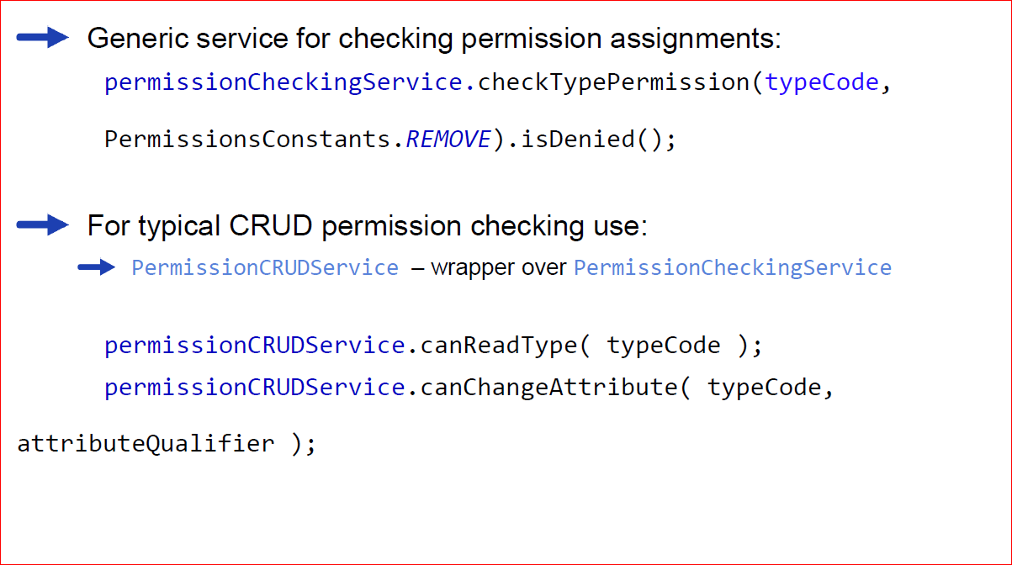
API CRUD example

Slide 10
Contents
Basics
Type-Based Access Rights
Restrictions
Spring Security
Custom Access Rights

Slide 11
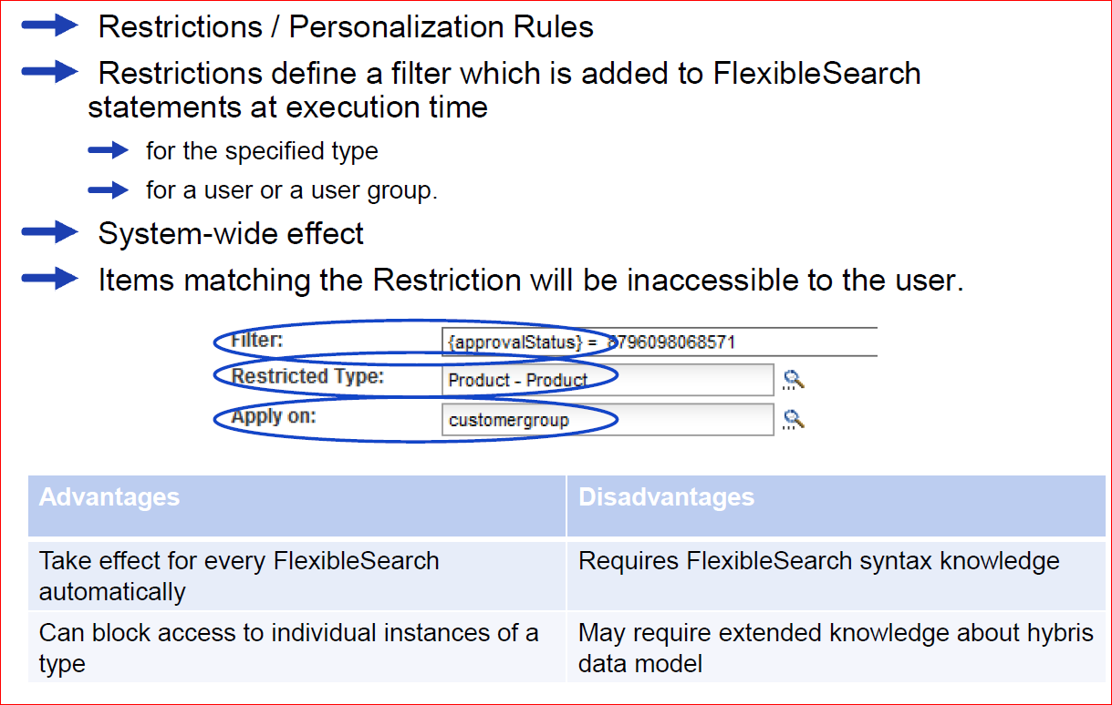
Restrictions – Overview

Slide 12
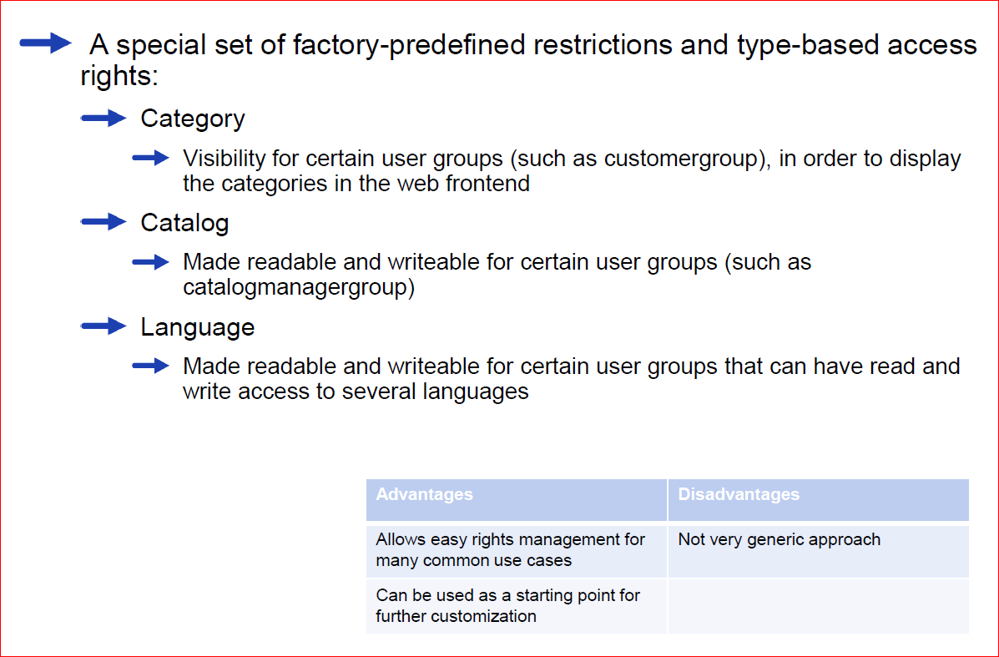
Factory-Predefined Access Rights

Slide 13
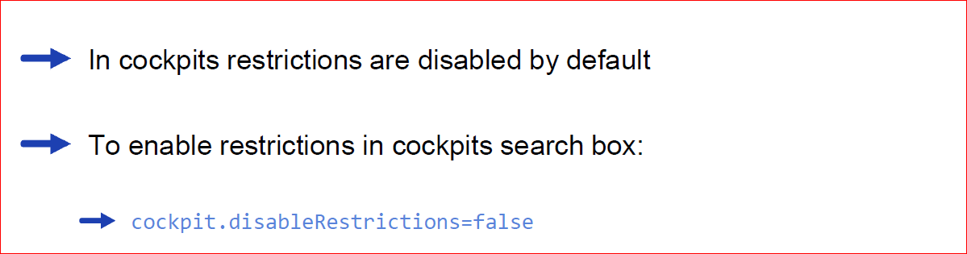
Restrictions in cockpits

Slide 14
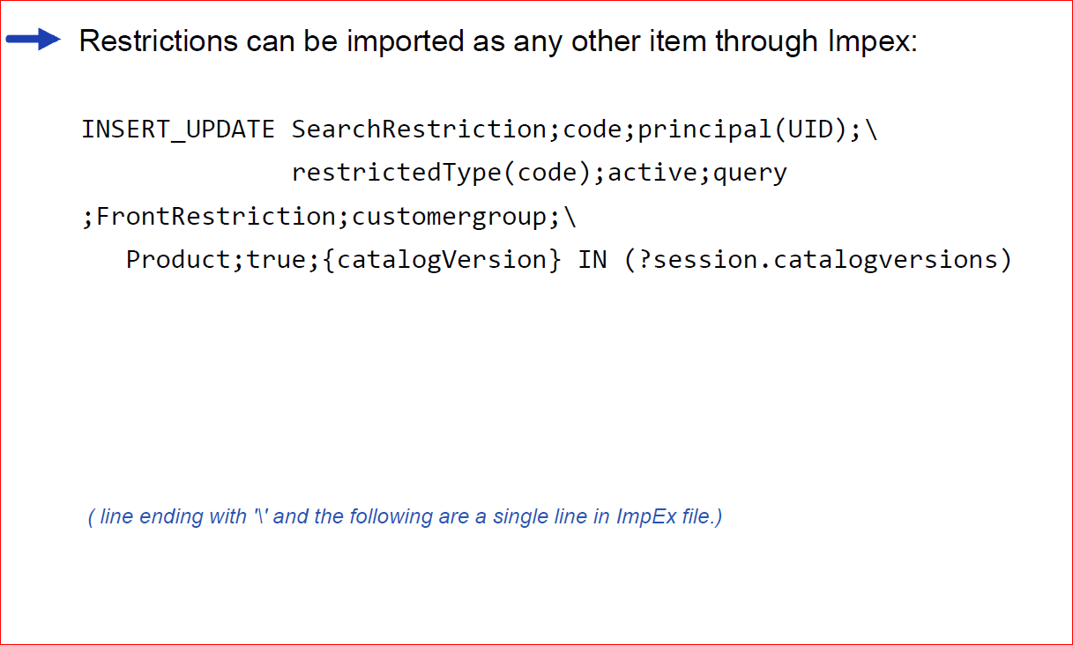
ImpEx example

Slide 15
Contents
Basics
Type-Based Access Rights
Restrictions
Spring Security
Custom Access Rights

Slide 16
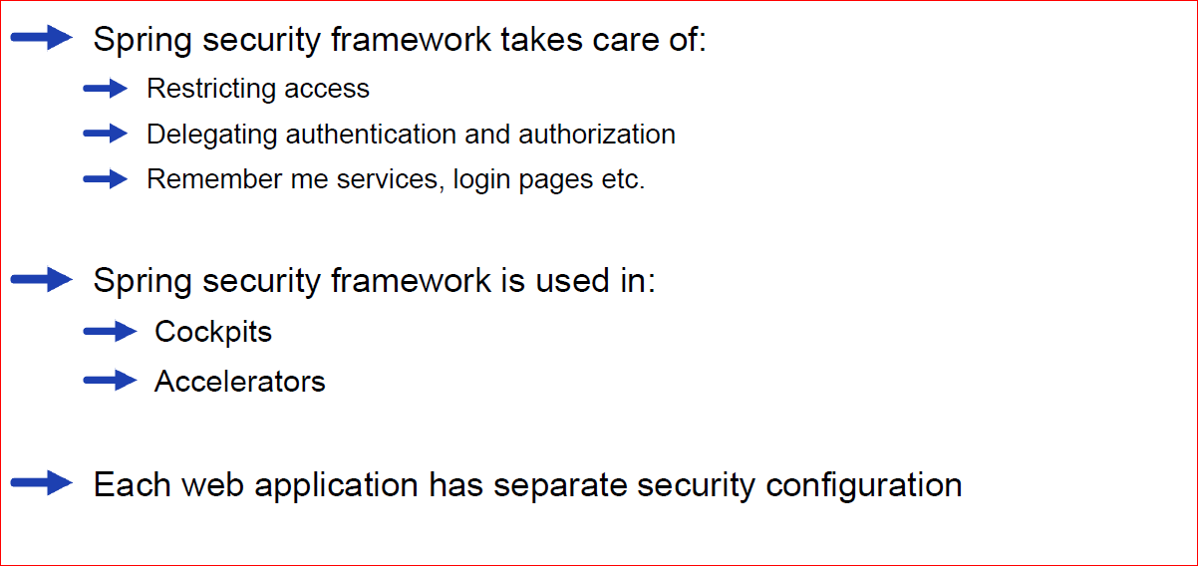
Spring security

Slide 17
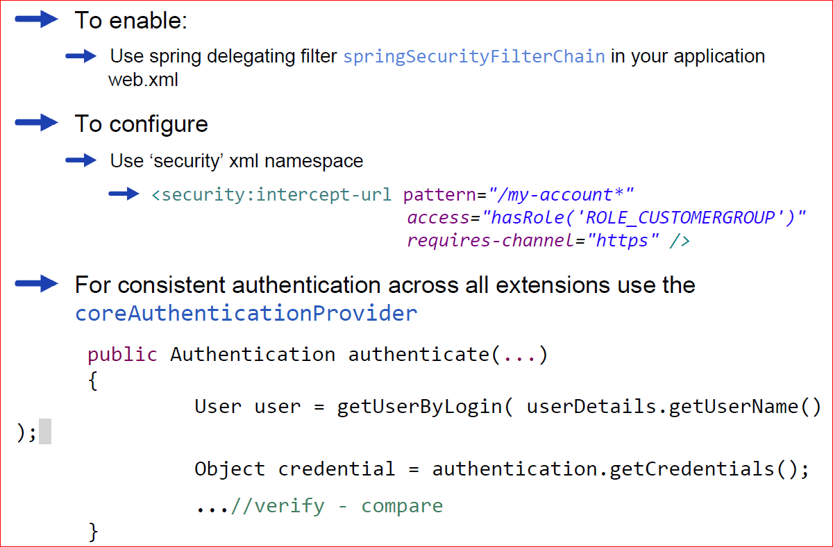
Spring security (2)

Slide 18
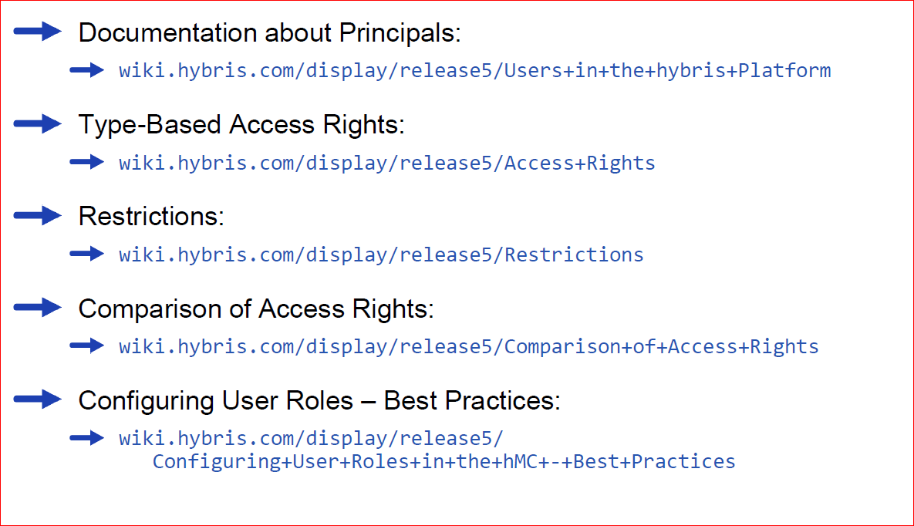
References

Slide 19
Contents
Basics
Type-Based Access Rights
Restrictions
Spring Security
Custom Access Rights

Slide 20
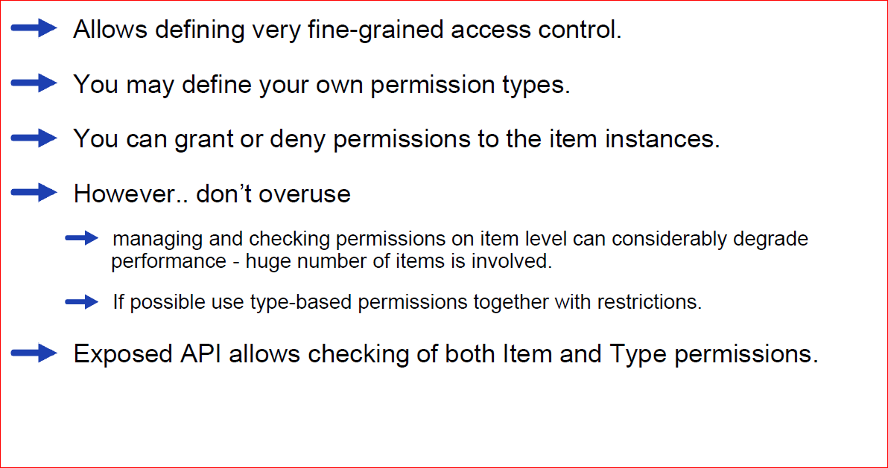
Custom Access Rights – Overview

Slide 21
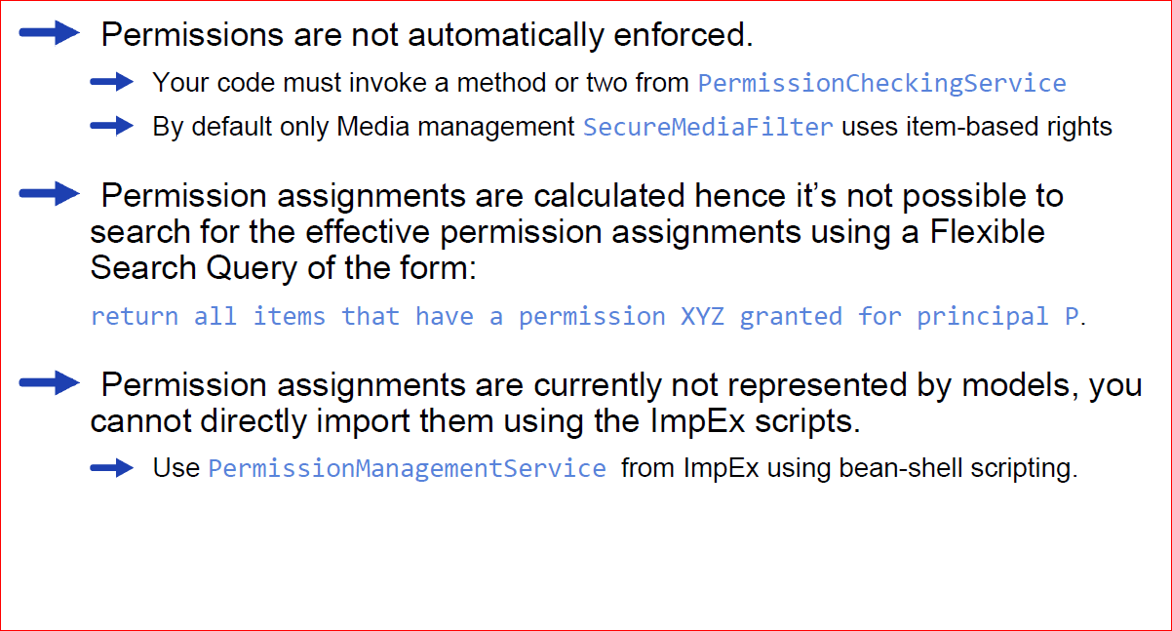
Limitations

Slide 22
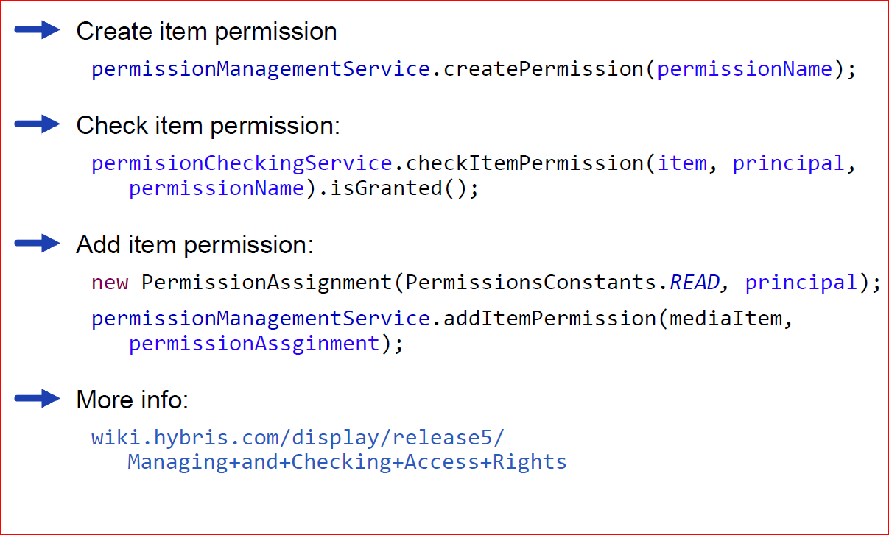
API example

